Slide 1
Mass Moments of Inertia via The Method of Composite Parts
Dr. Jacob Moore
Associate Professor of Mechanical Engineering
Penn State Mont Alto

Slide 2
Finding Moments of Inertia for Composite Areas or Bodies
As an alternative to the use of integration for finding area or mass moments of inertia, we can use lookup tables along with the parallel axis theorem to find a combined moment of inertia for a composite body.
In this way, we can skip the integration, instead using the work of others as a shortcut.
This is similar to the method we used to find the centroid or center of mass of a composite body.

Slide 3
Finding Moments of Inertia for Composite Bodies or Areas
The overall process is as follows
Break the composite body down into simple shapes that are in the lookup tables.
Look up the moments of inertia for each individual shape using the moment of inertia tables.
Use the parallel axis theorem to adjust moments of inertia to the common origin point.
Add the adjusted moments of inertia together to find the overall moment of inertia for the combined shape.

Slide 4
Method of Composite Parts
2
The first step in finding the combined moment of inertia, is to break our complex shape into simple shapes that are in our moment of inertia tables.
Holes or cutouts can be negative areas/masses
It is also useful to identify axes, and an origin point at this point to use in calculations
1
3
Y
X
Z

Slide 5
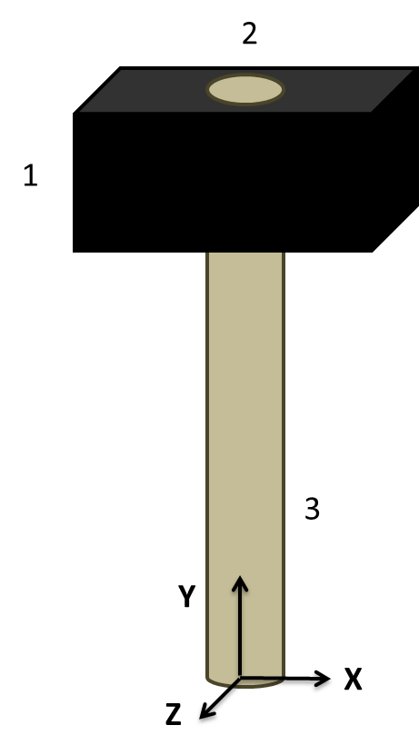
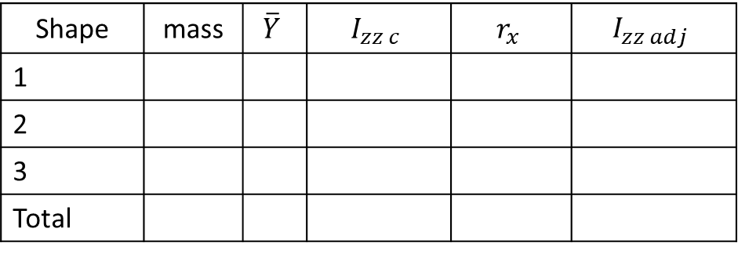
Method of Composite Parts
Next you are going to create a table to keep track of the various values.
Each row will be used for one part
The columns will vary from problem to problem but generally follow the format below.
Shape | mass | $$\overline{Y}$$ | $$I_{zz c}$$ | $$r_{x}$$ | $$I_{zz adj}$$
1
2
3
Total

Slide 6
Method of Composite Parts
After determining the mass of each piece, the next step is to find the location of the center of mass of each piece as well as the overall center of mass location.
We will often be taking the moment of inertia about this overall center of mass location.
Even if you are taking the moment of inertia about another location, we will usually need to know the center of mass for each piece.

Slide 7
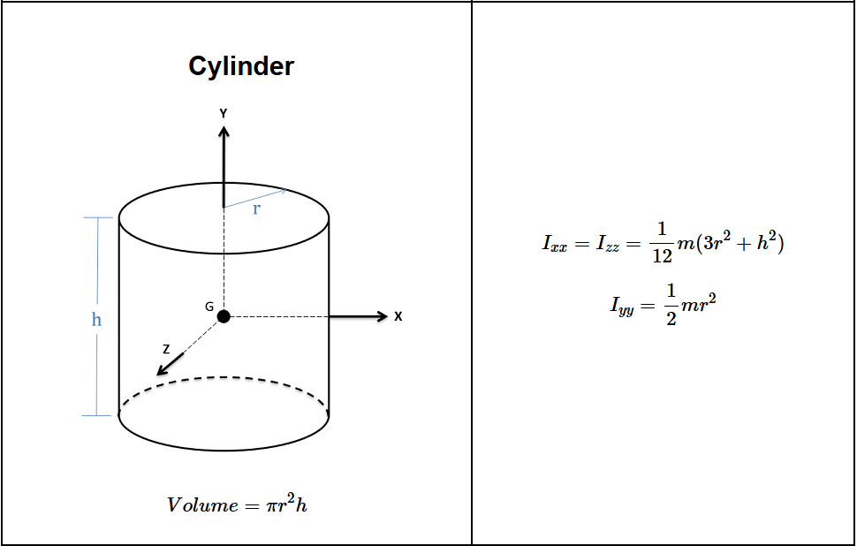
Method of Composite Parts
Next, you will look up and calculate the moments of inertia about their individual centers.
Be sure to adjust the orientation to match the table to your situation .

Slide 8

The Parallel Axis Theorem
The parallel axis theorem states that...
$$I_{zzP}=I_{zzC}+mr^{2}$$
Mass Moment about any Point P
Distance between the two z axes
Mass Moment about Centroid
Mass of Part

Slide 9


The Parallel Axis Theorem
The r value represents the distance you need to move the axis to “adjust” it to the new center of mass.
We are going to use the earlier center of mass values in the table to find this adjustment distance “r”
Z
$$r_{z}$$
Z
Z
$$r_{z}$$

Slide 10

Method of Composite Parts
Once you have figured out your r values, you will use those to find the adjusted moments of inertia for each piece.
Finally, the adjusted moments of inertia can be added up find the overall moment of inertia.
$$I_{zz adj}=I_{zzC}+mr_{x}^{2}$$
Shape | mass | $$\overline{Y}$$ | $$I_{zz c}$$ | $$r_{x}$$ | $$I_{zz adj}$$
1
2
3
Total

Slide 11
Thanks for Watching
See other engineering mechanics videos and access the full tool at…

Slide 12
Mass Moment of Inertia Worked Example
A dumbbell consists of two .2 meter diameter spheres, each with a mass of 40 kg. The spheres are attached to the ends of a .6 meter long, 20 kg slender rod. Determine the mass moment of inertia of the dumbbell about the y axis shown in the diagram.
y
.2 m
.3 m
.3 m
.2 m
40 kg
40 kg
20 kg

Slide 13
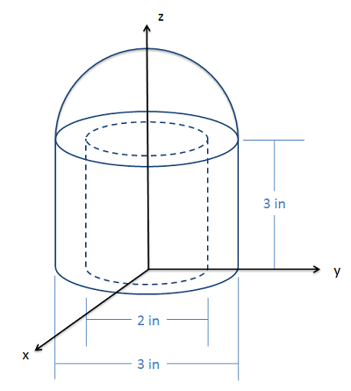
Mass Moment of Inertia Worked Example
The shape shown below consists of a solid semicircular hemisphere on top of a hollow cylinder. The object has a constant density, and a mass of 5 slugs. Based on the dimensions below, determine the mass moment of inertia about (a) the z-axis and (b) the y-axis.

Slide 14
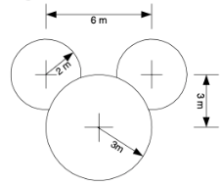
Mass Moment of Inertia Worked Example
A sign is made from 3 circles of aluminum of thickness 1 cm and density 2.7 g/cm³. The smaller circles (radius 2 m) are joined to the larger circle (radius 3 m) where they overlap. Find the center of mass of the sign with respect to the center of the largest circle. Also find the moment of inertia of the sign about the axis passing through the center of mass and perpendicular to the plane of the sign.

Slide 15
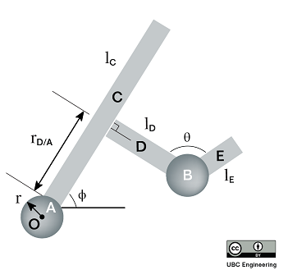
Mass Moment of Inertia Worked Example
An engineer puts together a form study prototype of a robotic arm to show a group of stakeholders. Specifically they want to know about its radius of gyration. Unfortunately, he forgot what material he used. If the mass moment of inertia of the arm is I=15.2kgm² about point O, calculate the radius of gyration. Each component is a plate with thickness t=5 mm. Assume the plates are rigidly attached to one another. Plate A is identical to plate B, and has a radius r=2w. Plates C, D and E have the same width w=15 cm. Plate C has a length l_{C}=1.1 m, and is angled at ϕ=30 deg with the horizontal. Plate D is attached perpendicular to plate C at a distance r_{(D/A)}=0.55 m from plate A, and has a length l_{D}=0.3 m. Plate E has a length l_{E}=0.21 m, and is angled θ=105 deg away from plate D.

